Slide 1

Presenter: Chua Kai Feng

Slide 2
Agenda
Introduction
What is AnyThing & AnyWhere?
What is the goal?
Motivation
Importance of e-commerce
How does it benefit businesses?
Problems e-commerce facing
Exposure
Service Base Business
Logistics

Slide 3

Introduction

Slide 4

What is AnyThing & AnyWhere?
An innovative E-commerce platform designed to assist physical retailers
Target audience: Shopping Mall Retailers
Featuring an extensive range of products from shopping destinations such as Parkway Parade, Katong I12 and more

Slide 5
What is the goal?
Revolutionise the shopping experience allowing users to shop in a single online location effortlessly.
Opening a new income and traffic stream for business owners.
Expand opportunities for a logistics partner
Consolidate delivery fees for purchases from multiple stores in the same shopping into one charge

Slide 6
Motivation
Past e-commerce experience.
Interest in UX/UI designing.
Leveraging technology to solve problems.

Slide 7
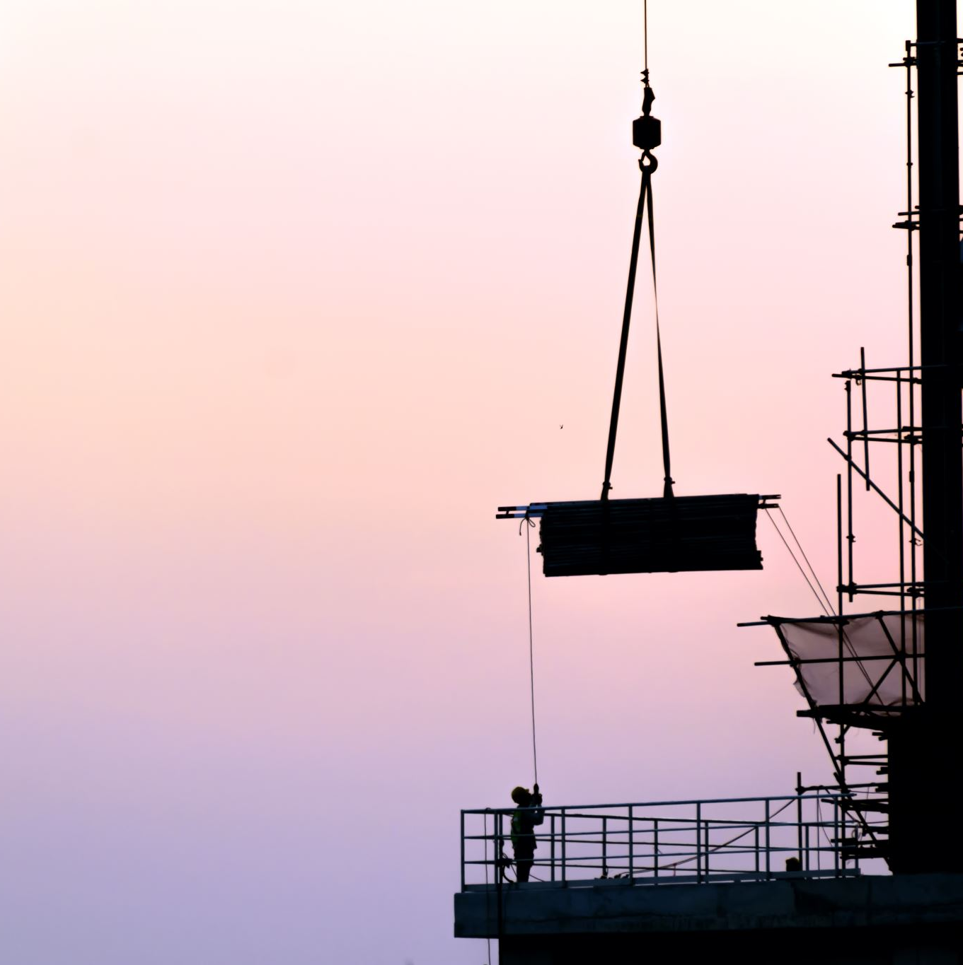
Importance of E-commerce

Slide 8
How does it benefit business?
24/7 Availability
Customer Insights
Increasing Sales Channels
Scalability
Automated Operations

Slide 9

Problems E-commerce Facing

Slide 10
Exposure
Lesser known retailers have yet to incorporate into their business model
Service Base Business
Services providers may not be viable for e-commerce
Stock Availability For Retail Shopping
Uncertainty of stock availability.
Speed of Logistics
Minimum 3 working days to fulfil delivery.
Consolidated Checkout
Consolidated delivery price.

Slide 11

Project Planning

Slide 12
Features
Extensive Product Catalogue
Advanced Search and Filtering
AI Chatbot Assistance
Real- Time Inventory Updates (Client)
Interactive User Dashboard & Interactive Seller Dashboard

Slide 13
Risk
Data Security
Logistics Matters
Site Maintenance
Coordination with Business Owners
Technical Challenges

Slide 14
Technologies Involve
Frontend | Backend (Server) | Database | UI Drafting
HTML | Node.js | MongoDB | Draw.io
CSS | Express.js
JavaScript

Slide 15

Product Demonstration

Slide 16

QNA

Slide 17
Thank you

